Slide 1
ThinkBot: Revolutionizing Chatbot through ML and LLM Innovation
PIP104 PROFESSIONAL PRACTICE-II
VIVA-VOCE
Batch Number: B-44
Roll Number | Student Name
20201COM0058 | Darshan Gowda G
20201COM0057 | Vishal R
20201COM0055 | Vishwas B
20201COM9001 | Jangam Dheeraj
20191COM0219 | VELAKACHERLA SANKAR REDDY
Under the Supervision of,
Ms. Shaik Salma Begam
Assistant Professor
School of Computer Science & Engineering
Presidency University

Slide 2
Abstract
"ThinkBot: Revolutionizing Chatbot through ML and LLM Innovation" transforms customer interactions with an intelligent and versatile chatbot system. Utilizing Python Flask, HTML, CSS, and JS, our approach integrates Naive Bayes for intent detection and Mistral LLM for advanced language processing. The system excels in handling text, images (OCR), and voice inputs, offering 24/7 support, personalized interactions, and secure account recovery. With a user-friendly interface and innovative features like Copy text and Speak Aloud, our project reshapes customer service dynamics, steering businesses towards customer-centricity. This project introduces a new era of customer support, blending machine learning and large language models for efficient and personalized interactions.

Slide 3
Introduction
Our "ThinkBot: Revolutionizing Chatbot through ML and LLM Innovation" redefines customer service by combining Chatbots and Machine Learning. With 24/7 support and a user-friendly interface, it provides businesses a personalized and efficient way to connect with customers.
Key Features:
Intelligent Integration: Merges Chatbots with Machine Learning for efficiency.
24/7 Adaptive Support: Ensures continuous real-time assistance.
Versatile Application: Tailored for various industries.
Customizable Precision: Easily adapts to unique industry needs.
User-Friendly Interface: Prioritizes simplicity for an enjoyable user experience.

Slide 4
Literature Review
Sl No | Title | Method | Progress | Field of Improvement
1. | ELIZA (1996) | Basic predefined responses | Introduction of rudimentary chatbots | Initial chatbot capabilities
2 | A Hybrid Approach to Customer Service(2022) | Rule-based decision trees | Advancement to rule-based systems | Handling structured conversations
3 | Seq2Seq AI Chatbot with Attention Mechanism(2020) | Natural Language Processing | Enhanced adaptability with dynamic responses | Overcoming limitations of structured conversations
4 | Building Intelligent Chatbot for Customer service using Reinforcement Learning(2022) | Integration of Machine Learning algorithms | Improved understanding and response generation | Advancement in chatbot intelligence
5 | Hybrid Chatbots for Customer Service: Integrating Rule-Based and ML Approaches(2020) | Fusion of Machine Learning and Large Language Models (LLM) | Cutting-edge model for personalized interactions | Reshaping customer support chatbots with enhanced language understanding

Slide 5
Existing Systems
Current customer support chatbots typically use a mix of machine learning tools. They often rely on natural language processing for better conversations, using models like GPT-3 to understand context. Intent recognition, figuring out what the user wants, involves smart algorithms. Some chatbots learn from pre-existing models. They also use a combination of rule-based and learning-based methods for adaptability. To make conversations more personal, sentiment analysis is applied to understand user feelings. All these methods work together to make sure chatbots are good at handling different types of customer questions and improving over time.

Slide 6
Drawbacks
Understanding User Inputs: Existing models struggle with various inputs, like speech and images, limiting their flexibility.
Recognizing Emotions: Many chatbots have difficulty understanding and responding to users' emotions, missing a personal touch.
Making Conversations Flow: Maintaining context during extended conversations remains a challenge, affecting the chatbot's coherence.
Data Quality Impact: Machine learning models heavily rely on high-quality training data, introducing potential biases and limitations.
Handling Ambiguity: Existing models face challenges with ambiguous or complex queries, potentially leading to inaccurate responses.

Slide 7
Advantages
Enhanced Customer Engagement: ML-driven understanding of user intent for engaging conversations, fostering satisfaction & loyalty.
Efficient Problem Resolution: Swift issue identification with Naive Bayes, Lora, Qlora algorithms, reducing wait times and improving service quality.
Improved Response Time: Automation via ML for faster query resolution, enhancing support system efficiency.
Personalized Assistance: Fine-tuned Mistral-based Ollama model offers tailored support, enhancing user experience.
Continuous Learning: ML enables adaptive learning from interactions, staying updated with preferences and trends for ongoing improvement.

Slide 8
Proposed Methodology
Data Collection: Gather diverse customer queries for training.
Intent Recognition: Use Multinomial Naive Bayes for initial intent categorization.
Large Language Model (LLM) Integration: Incorporate Mistral LLM, fine-tuned for support domain.
Chat Interface Design: User-friendly web interface with OCR, voice input, and copy feature.
User Input Processing: Handle text, image, and voice inputs, utilizing OCR for images.
Intent-Based Processing: Route messages based on intent for efficient handling.
Response Generation: Mistral LLM generates contextually relevant responses.
User Interaction History: Maintain history for context-aware responses and learning.
Security and Authentication: Implement secure user authentication and data encryption.
Testing and Evaluation: Rigorous testing for accuracy, response time, and user satisfaction.

Slide 9
Software and hardware requirements
Hardware Requirements:
Processor | Intel i7/M1
RAM | 12GB
ROM | 500GB
Software Requirements:
Operating system | : Windows 10 and above/ Mac
IDE | : Visual Studio Code
Front-end | : HTML, CSS, JS
Server-side programming | : Python
Database | : MongoDB
Other libraries | : Pandas, Flask, Flask-Cors, Flask-session, Pymongo, Scikit-Learn, Joblib

Slide 10
Objectives
Improve Customer Interactions
Streamline Customer Support
Automate Repetitive Tasks
Create Personalized Experiences
Collect and Analyze Data Effectively
Enhance Security Measures
Follow Regulatory Standards

Slide 11
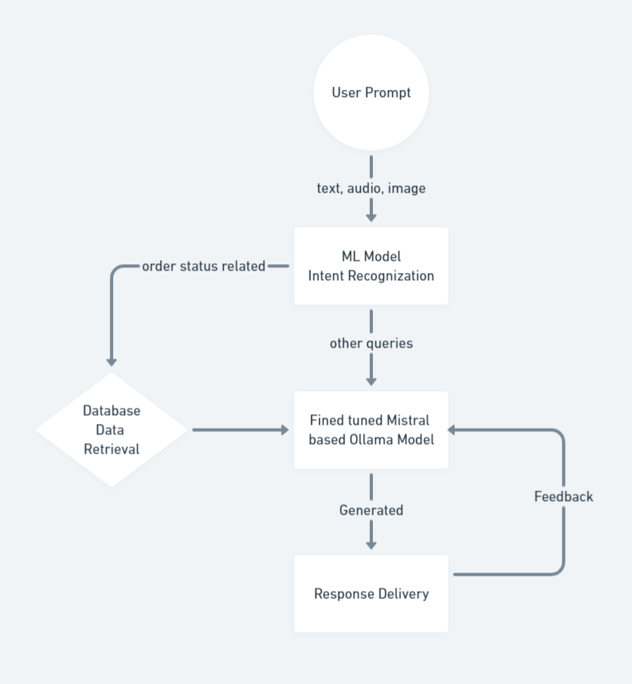
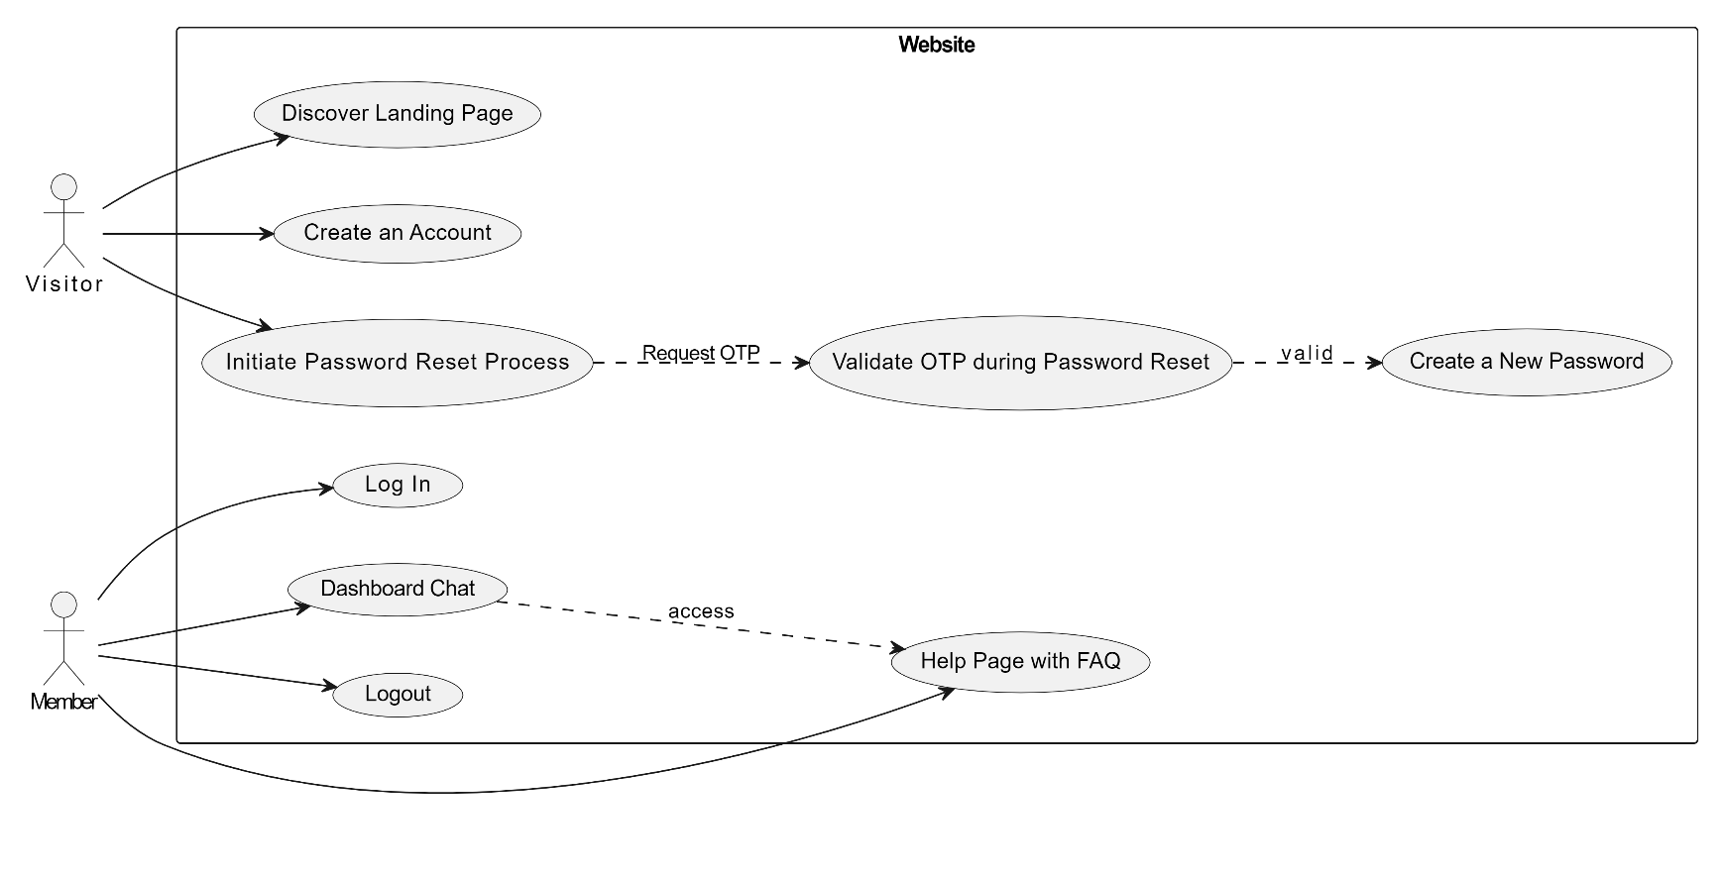
System Design
Use Case diagram
Architecture diagram

Slide 12
System Design
Use Case diagram
Architecture diagram

Slide 13
Algorithms Used:
Naive Bayes MultinomialNB:
Powerful probabilistic classification for precise text understanding.
Efficiently categorizes and assigns probabilities to different user queries.
Large Language Model (LLM) - Mistral:
Harnessing Mistral 7B LLM for cutting-edge language modeling.
Empowers the chatbot with enhanced language understanding for nuanced interactions.
These algorithms work synergistically, ensuring accurate and contextually relevant responses, thus elevating the overall performance of our customer service chatbot.

Slide 14
Implementation
Architecture:
Python Flask for backend.
HTML, CSS, JS for frontend.
Intent Recognition:
Multinomial Naive Bayes for message intent classification.
Large Language Model (LLM) integration for
detailed understanding.
User Interface:
Landing page, login, register, reset password.
Dashboard with a chat interface.

Slide 15
Implementation
Input Methods:
Text, image (OCR for conversion), and voice.
Features:
"Speak aloud" for user queries.
Quick copy function for bot responses.
Security:
All-auth login mechanism for secure interactions.
Web Deployment:
Utilizing Flask for web application deployment.

Slide 16
Testing
Sl. No. | Event | Attribute and value | Inference | Result
1 | Authenticate user login after clicking “Login” button on the login page with proper credentials. | Login email: d2gowda.2002@gmail.com Password: dars@1234 | Login successful and directed to chat page | Pass
2 | New user registration. User has to enter a password with minimum length of 8 | Login email: Password: 123 | Password should be minimum of 8 characters. | Fail

Slide 17
Testing
Sl. No. | User Input | Intent Predicted | Actual Intent | Result
1 | Hello! I'm reaching out to get an update on my order with the ID #789012. Can you please let me know the current status and expected delivery date? | track_order | track_order | Pass
2 | Hello! I'm following up on a recent refund request I submitted. My reference number is #987654. Could you please provide me with an update on the status of my refund and let me know when I can expect it to be processed? | track_refund | track_refund | Pass

Slide 18
Testing
Input Intent | Intent Predicted | Actual Intent | Result
track_order | track_order | track_ordet | Pass
refund_id | track_status | refund_id | Fail
track_refund | track_status | track_fund | Pass
order_status | order_status | order_status | Pass

Slide 19
Timeline of Project
Fig : Gantt chart

Slide 20
Outcomes / Results Obtained
Enhanced Interaction: Boosted customer engagement with a personalized chatbot experience.
24/7 Support Availability: Ensured efficient problem resolution and instant responses round the clock.
Versatile Communication: Expanded accessibility through image-to-text, voice input, and Speak Aloud features.
User-Friendly Interface: Seamless navigation with interactive elements for an enjoyable experience.
Secure Account Recovery: Implemented OTP-based password reset for enhanced security and user convenience.
Innovative Interaction: Introduced Speak Aloud and Copy Button features for diverse user preferences.
Adaptability to Industries: Customizable to specific industry needs, showcasing versatility and flexibility.

Slide 21
Conclusion
In conclusion, our machine learning-powered chatbot redefines customer service with unique features like “copy text" ,"speak aloud" and integration with Large Language Models. The user-friendly interface accommodates various inputs, providing a comprehensive solution for effective communication through speech and images. This project stands as a significant milestone, ushering in a new era of enhanced customer service experiences through cutting-edge technology.

Slide 22
Future Scope
Multimodal Input Integration: Incorporate advanced interaction modes like video and gestures for a richer user experience.
Continuous Model Enhancement: Implement ongoing model training to adapt to evolving language patterns and improve response accuracy.
Multilingual Support: Expand language support to cater to a more diverse user base, promoting inclusivity.
Resource Optimization: Strategize for efficient resource utilization, exploring methods to minimize system requirements while maintaining optimal performance.
UI/UX Enhancements: Plan for continual improvements in the user interface, focusing on design aesthetics, intuitive navigation, and user-centric features.
OCR System Enhancement: Devote efforts to refine the Optical Character Recognition (OCR) system, exploring advanced algorithms and training techniques for improved accuracy and robust text extraction.

Slide 23
References
Customer Support Chatbot Using Machine Learning
https://www.researchgate.net/publication/343980800_Customer_Support_Chatbot_Using_Machine_Learning
Guide to Fine-Tuning LLMS with Lora and qLora
https://www.mercity.ai/blog-post/guide-to-fine-tuning-llms-with-lora-and-qlora
Flask Basic Tutorial
https://www.tutorialspoint.com/flask/index.htm
Mistral LLM Guide
https://www.e2enetworks.com/blog/a-step-by-step-guide-to-fine-tuning-the-mistral-7b-llm
Machine Learning Pipeline using scikit-learn
https://www.analyticsvidhya.com/blog/2020/01/build-your-first-machine-learning-pipeline-using-scikit-learn

Slide 24

Thank You

